Slide 1

Christian Hunkler
Stefan Gruber
Agnes Orban
Stephanie Stuck
with support by
Martina Brandt
Dimitris Christelis
release 1.0.0
shipping from today!
Danilo Cavapozzi
Giuseppe De Luca
George Papadoudis
Morten Wahrendorf
Mauricio Avendano Pabon
Radim Bohacek
Thorsten Kneip
Giacomo Pasini
Liège, November 29, 2013

Slide 2
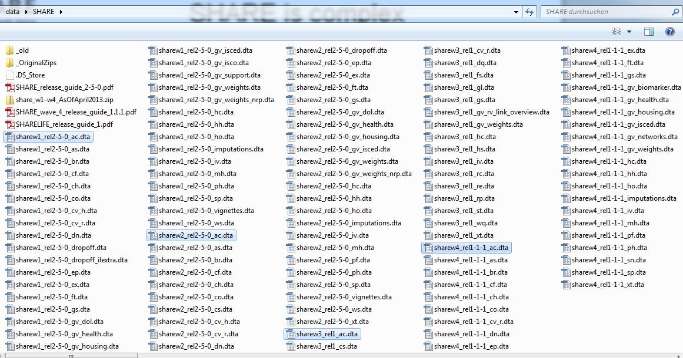
SHARE is complex
113 single data files
In addition:
Individual-, couple- and household-level data
(family-/financial-/household-respondents)
Complex skip patterns for stable information
Complex sampling leading to variation in available subsamples (“vignette”, “main”, “drop-off”-samples …)
Deviations across waves (e.g. questions “moving” from e.g. drop-off to CAPI)

Slide 3
easy SHARE - Concept
Idea
  Easy structured, ready to use single file (no merging)
  Selection of variables showing the central potentials of SHARE
  Stimulate students/users to later transfer to SHARE main release
Purpose
  (Student-)training
  Get students & researchers hooked on SHARE
Main features
  easySHARE includes all respondents of the SHARE main release (other household members & deceased respondents excluded)
  Long panel dataset covering waves 1, 2, 3/SHARELIFE, and wave 4

Slide 4
easy SHARE - Concept
  Inclusion of new indices and variables
  (Age, Couple-ID, health scores, etc.)
  Comparability with RAND HRS
  (Adaption of existing variables to RAND HRS)
  Integration of information
  (assign household-/ financial-/family-respondent information, forwarding of stable information from previous waves, etc.)
  Recoded and simplified variables
  (extended missing code scheme, etc.)
  Additional features:
  Short documentation, “cookbook”-styled analysis examples, release of Stata do-file generating easySHARE (easy adaption to SHARE main release)

Slide 5
easy SHARE - Concept
Guidelines for choosing variables
  Cross-country comparability
  Maximum cross-wave comparability, i.e. longitudinal measures (exception: retrospective life histories collected in SHARELIFE)
  Low rate of missing information
  Indices instead of variables
  No complex filtering or documentation of filters in target variable

Slide 6
easy SHARE - Content
Demographics: age, gender, country of birth, citizenship, education, religion, marital status, age & gender of partner
Household composition: living with partner in the same household, household size, children living in the household
Social Support & Network: mother/father alive, number of children, residential proximity of children, number of grandchildren, number of living siblings, social activities, received and given social support

Slide 7
easy SHARE - Content
Childhood conditions: number of books at age ten, occupation of main breadwinner at age ten, relative mathematical skills when ten, relative language skills at age ten
Health and health behaviour: self-perceived health, number of chronic diseases, mental health variables, depression scale EURO-D, CASP-12 index for quality of life and well-being, health care utilization, grip strength, body mass index, smoking and drinking behavior, vigorous activities/sports

Slide 8
easy SHARE - Content
Functional limitation indices: mobility index, large muscle index, activities of daily living index, instrumental activities of daily living index, gross motor skills index, fine motor skills index, cognitive functions
Work & Money: current job situation, term of main job, working hours per week, satisfaction with main job, early retirement plans, able to make ends meet, monthly expenditure on food, household income percentiles

Slide 9
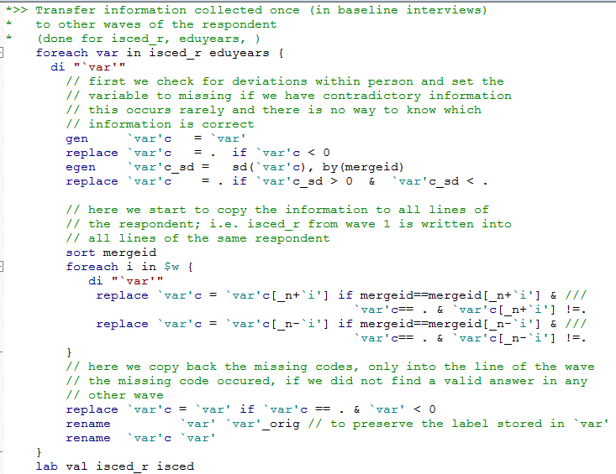
easy SHARE - Content

Slide 10
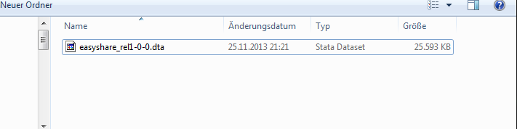

Working with easySHARE

Slide 11
easy access to easySHARE
Registered SHARE users can download easySHARE from the SHARE Research Data Center.
  Please note that the SHARE data access rules for the SHARE main release also apply to the easySHARE data set.
easy procedure for teachers/instructors:
  You fill and sign the easySHARE teacher statement (if you are already a registered SHARE user) which allows to share easySHARE with a specified group/class.
  Your students sign the (regular) SHARE user statement.
  You collect them and send both the teacher and the students´ user statements to: jjanssen@uvt.nl
  In due course, all your students are registered as regular SHARE users and will be provided with Login/passwords for the main distribution of SHARE.

